Slide 1
PERANCANGAN
BERBASIS MIKROPROCESSOR
10
MicroControl with WebSocket
TEKNIK
Zendi Iklima
Teknik Elektro

Slide 2
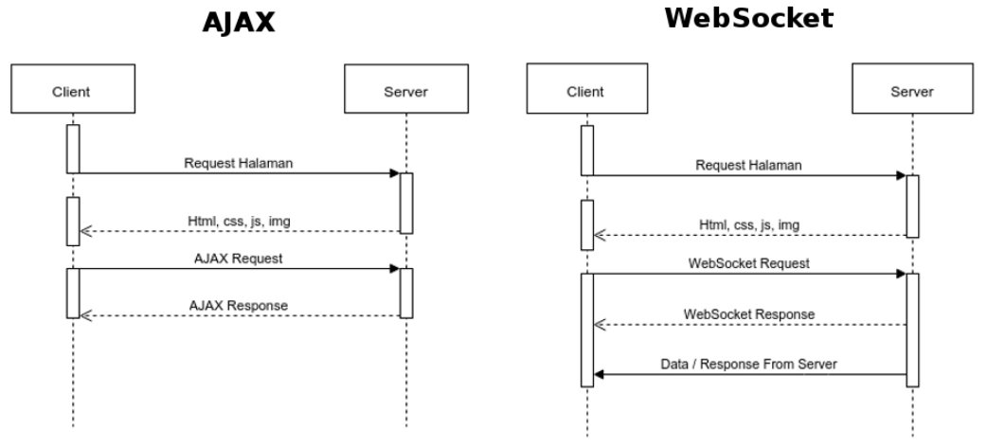
Websocket Concept

Slide 3
Socket Client (Web)
Socket Server
Socket Client Wemos
emit(‘web_emit_to_srv’)
on(‘web_emit_to_srv’)
emit(‘srv_emit_to_wemos’)
on(‘srv_emit_to_wemos’)
Parsing and Generating data
on(‘wemos_emit_to_srv’)
emit(‘wemos_emit_to_srv’)
on(‘srv_emit_to_web’)
emit(‘srv_emit_to_web’)
data = {
"your_id“
"to_id“
"msg_text“
}

Slide 4
BUILD YOUR OWN SERVER

Slide 5
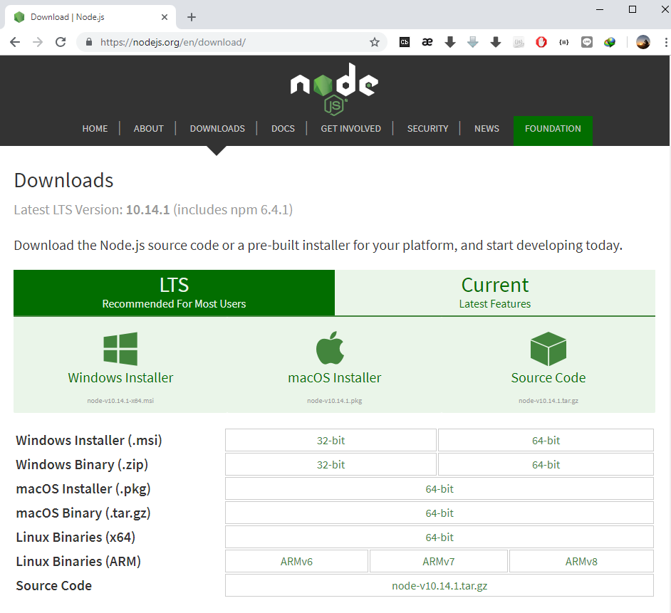
after the installation complete
The open your CMD then type:
npm --version

Slide 6
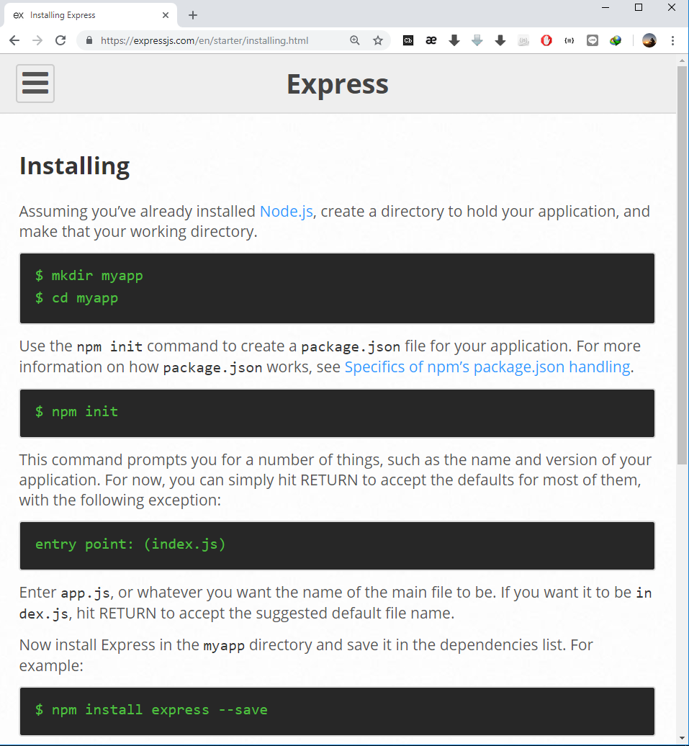

Slide 7
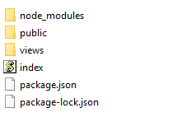
Just USE Mine
Extract Project to a Directory:
Then you the packages should be like:

Slide 8
Just USE Mine
Open CMD related to the project directory then type:
npm install
Related packages will installed automatically

Slide 9
Do It by Your Self
Open CMD, set to your Project folder then install required packages (additional libraries):
npm install –save body-parser path socket.io ip http ejs nodemon

Slide 10
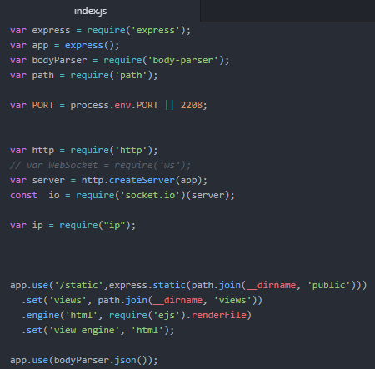
Do It by Your Self
Create file and named it “index.js” and set it up.

Slide 11
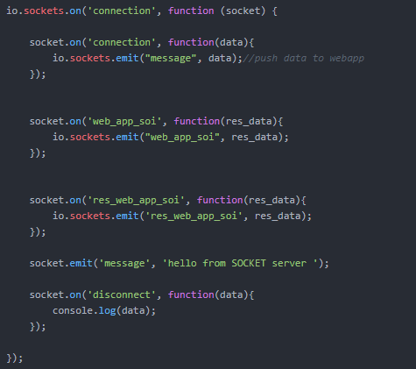
Do It by Your Self
Add socket to your project

Slide 12
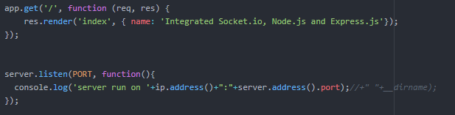
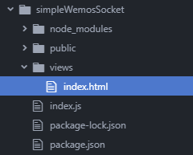
Do It by Your Self
The end of your index.js file
You need to create “index.html” inside the views

Slide 13
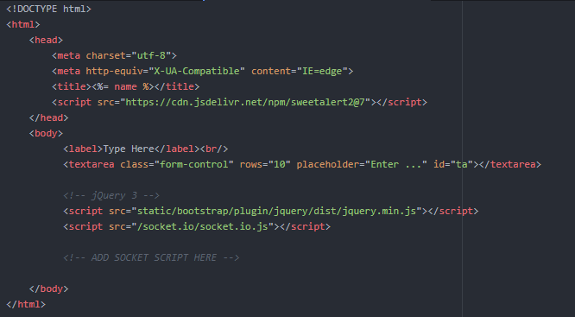
index.html
Next slide

Slide 14
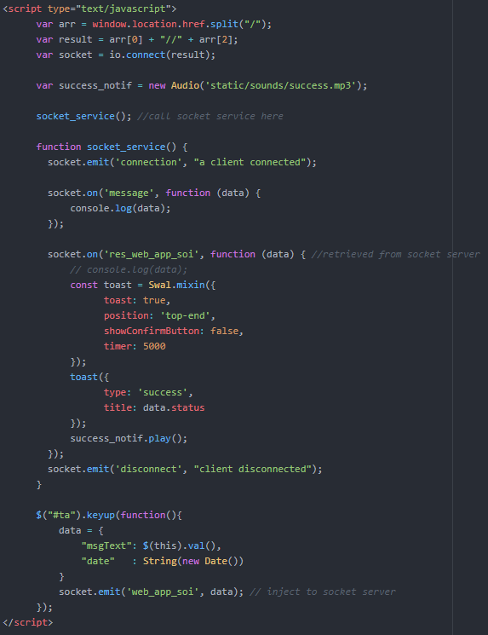

Slide 15
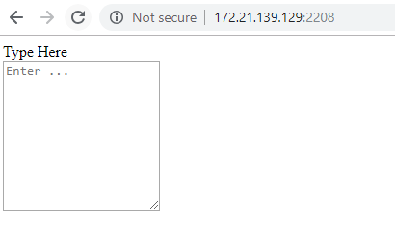
index.html

Slide 16
WEMOS CODE

Slide 17
DOWNLOAD WEBSOCKET LIBRARY
https://github.com/Links2004/arduinoWebSockets

Slide 18
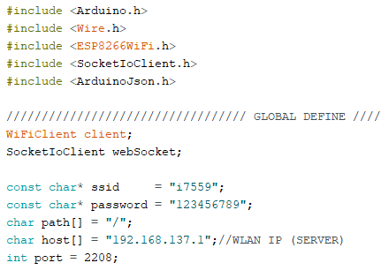

Slide 19
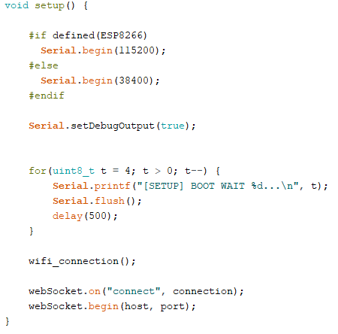

Slide 20
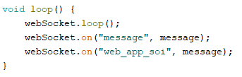

Slide 21
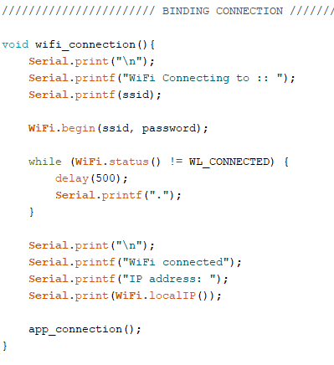

Slide 22
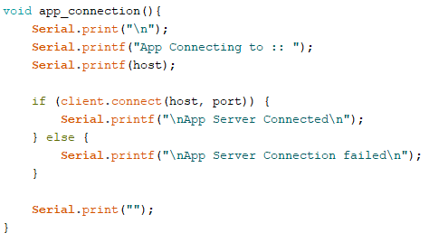

Slide 23


Slide 24


Slide 25
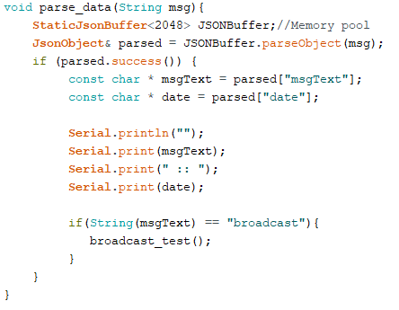

Slide 26
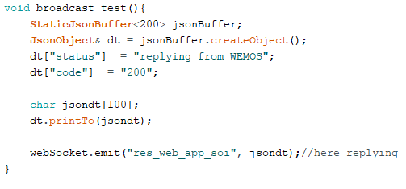

Slide 27
